Slide 1


Allstate Severity Claims Kaggle Competition
Team GrumpyKaggleKats
Luke Chu, Nelson Chen, Regan Yee, Cheryl Liu

Slide 2
Roadmap
Summary and Goals
Pipeline
EDA and Preprocessing
Models
Results
Further Steps

Slide 3
Summary and Goals
Dataset consists of 180k+ rows for training dataset
Id column, 116 categorical features, 14* continuous features, 1 loss column
No missing data - dataset is clean
Features anonymized, continuous features scaled between 0 and 1
Use these features to predict auto insurance claims
Attempt to build basic machine learning models on real world data and score high on Kaggle!

Slide 4
Roadmap
Summary and Goals
Pipeline
EDA and Preprocessing
Models
Results
Further Steps

Slide 5
Pipeline
Start off with applying traditional models to the training dataset
KFold validation: train dataset split into Training and Validation data.
X_train: Features of the training set
Y_train: Responses of the training set
X_val: Features of the validation set
Y_val: Responses of the validation set
Train the model using the training set (X_train, Y_train)
Get an average MAE of the cross-validated model
Predict on the test set (test.csv)
Hypertune parameters and repeat!
Ensemble and/or stack and submit new model’s predictions to get sense of progress.

Slide 6
Roadmap
Summary and Goals
Pipeline
EDA and Preprocessing
Models
Results
Further Steps

Slide 7
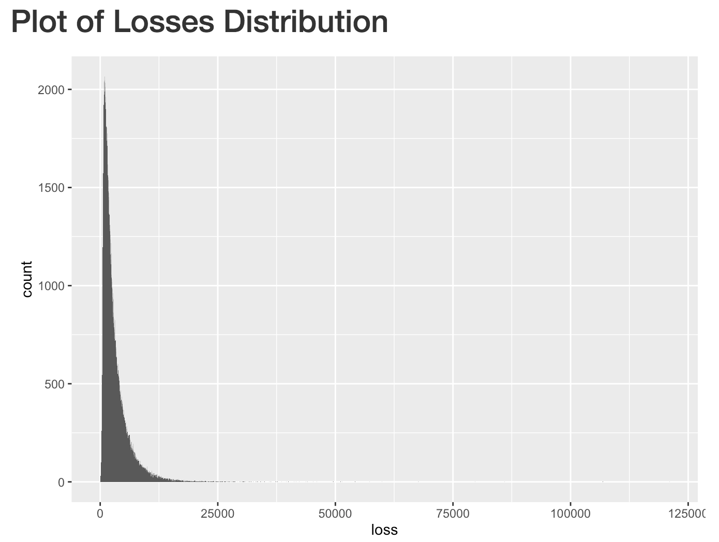
EDA - Distribution

Slide 8
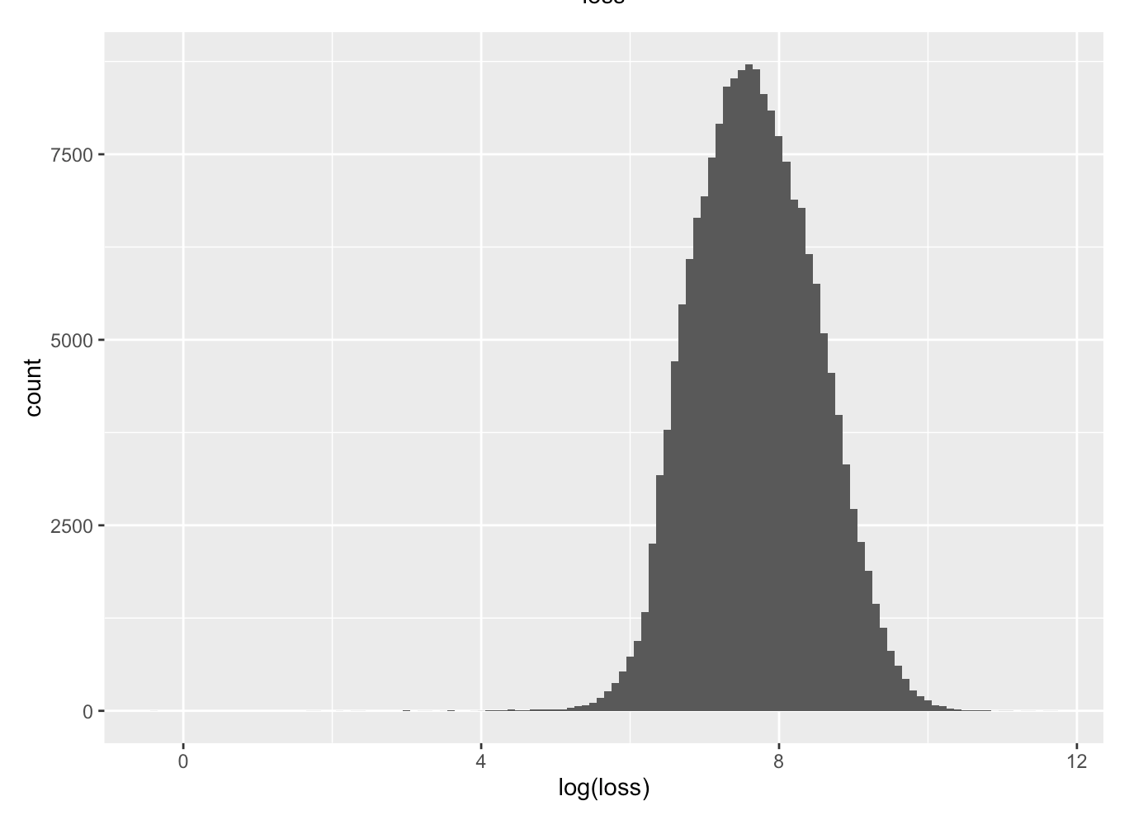
EDA - Distribution

Slide 9
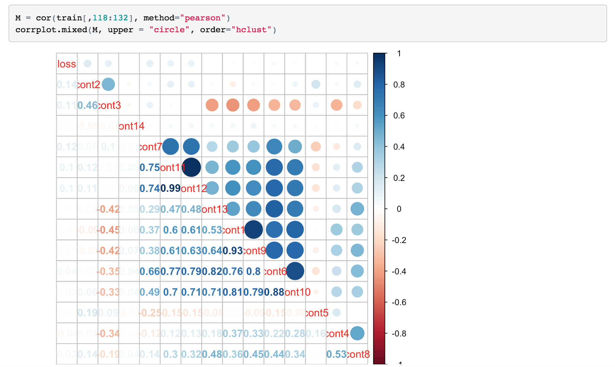
EDA - Correlation Plot

Slide 10
EDA - Factor Analysis for Mixed Data
eigenvalue percentage of variance cumulative percentage of variance
comp 1 14.161089 1.3655824 1.365582
comp 2 7.430510 0.7165391 2.082121
comp 3 7.203723 0.6946695 2.776791
comp 4 7.026304 0.6775606 3.454352
comp 5 6.518144 0.6285578 4.082909

Slide 11
Roadmap
Summary and Goals
Pipeline
EDA and Preprocessing
Models
Results
Further Steps

Slide 12
Models - Lasso Regression
Data Preprocessing
Column Removed | Reason
id | An index, not a feature
cat112 | States column
cont1 | High correlation with cont9
cont6 | High correlation with cont10
cont11 | High correlation with cont12

Slide 13
Models - Lasso Regression
Data Preprocessing
Convert categorical data into numeric (get_dummies from pandas )
The dummy dataset dimension: (188318, 127) -> (150654,1099)
Split the dataset (train.csv) into training and testing (8:2 ratio)
Train the Lasso Regression model with cross validation value from 3--10
After feature selection, only 326 columns kept

Slide 14
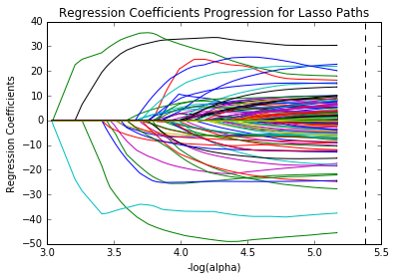
Models - Lasso Regression
Coefficient Progression results

Slide 15
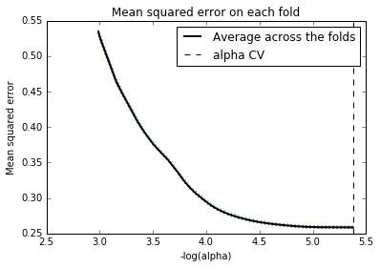
Models - Lasso Regression
Mean squared error on each fold (5.3765326742844204)

Slide 16
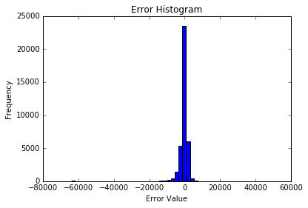
Models - Lasso Regression
Error distribution of Lasso Model on train.csv
score on Kaggle: 1834.08715 on test.csv

Slide 17
Models - KNN
scikit-learn: KNeighborsRegressor library
Tuning Parameter: K - number of nearest neighbors to consider
425 - 440 neighbors for tuning
425 gave best results in that range
10 folds created, 2 sampled for Cross-Validation
425-NN CV Score : 1721.150 425-NN LB Score: 1752.11803

Slide 18
Models - SVR
scikit-learn: SVR library
Tuning Parameters:
C - cost/penalty applied for making an error
Range over 10^ seq(-1,1,5)
Epsilon - distance from margin such that penalty is zero
Range over 10^ [0.05, 0.01, 0.015, 0.02, 0.03, 0.1, 0.5]
Gamma - variance of Gaussian - determines “influence” of support vectors
10 folds created, 2 sampled for Cross-Validation
Computationally Expensive! Results TBA

Slide 19
Models - Random Forest
scikit-learn: RandomForestRegressor library
Number of trees: [50,200]
Max Features to Consider: sqrt(num_predictors) = sqrt(133) ≈ 11.53
50 RF CV Score: 1212.226 | 50 RF LB Score: 1188.92450
200 RF CV Score: 1202.28 | 200 RF LB Score: 1187.71536
Notes:
Unique Selling Point of the RF algorithm

Slide 20
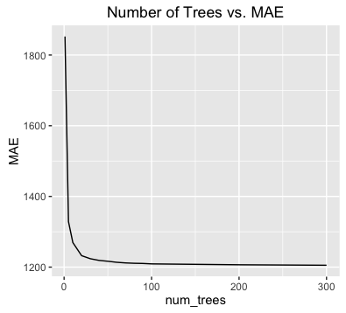
Models - Random Forest - Number of Trees

Slide 21
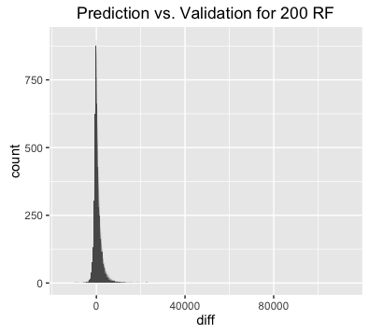
Models - Random Forest -Prediction vs. Validation Set:

Slide 22
Models - Neural Network
Keras (Front-end) + Theano (Backend) python packages
Single best model
Architecture : input → 400 Neurons → 200 Neurons → 50 Neurons → output
Regularized with dropout and batch normalization
10 K-Fold with 10 bags per fold
Validation score: 1134
LB score: 1113
Tried to add extra layers but could not reach minimal without smaller learning rate

Slide 23
XGBoost
10 K-Fold Cross Validation
Parameters:
Learning rate: 0.01
Learning rate decay : 0.9996
Max trees = 10,000 with early stopping if validation score does not improve
Validation score: 1133
LB score: 1112
Best single model

Slide 24
Outlier Analysis
Ranges from 10340 to 121000
Only 5315 pts out of 180k points
2.5% of the data but 90% of possible values
Added feature in train set that signifies if it is an outlier
Validation score: ~1050 with both xgboost and Neural Networks
outliers

Slide 25
Outlier Classification
Goal: Train binary classifier to predict class on Test set
Tried Logistic Regression -> 97.5% accuracy, 0.61 ROC AUC score
No better than just guessing all positive classes
Tried XGBoost for classification while maximizing ROC AUC score
Most of the probabilities were near 0.5
Algorithm is very unsure of what was an outlier

Slide 26
Outlier Classification
Used the Imbalanced dataset package in python to perform Synthetic Minority Oversampling Technique (SMOTE) + undersampling to generate new balanced dataset
Ran another classifier with the results:
AUC of ROC: 0.8
Accuracy: 99.6%
Great! Added new feature to test data and used XGBoost to run a regression: validation score: ~1050 but LB: 1178

Slide 27
Possible Reasons for Failure
Leaderboard only displays scores on 30% of data, so 70% of data will need to deal with more outliers (unlikely but hopeful)
Distribution for test set is different from the training set, so the classifier is not doing a good job
Accidentally overfit to training set when we chose the cutoff based on loss variable (most likely)

Slide 28
Roadmap
Summary and Goals
Pipeline
EDA and Preprocessing
Models
Results
Further Steps

Slide 29
Results - Summary of Standalone Models
Kaggle Leaderboard Score:
Lasso Regression: 1834.08715 (feature selection)
KNN Regression: 1752.11803
SVR: ???
Random Forest: 50 Tree LB Score: 1188.92450
200 Tree LB Score: 1187.71536
Neural Network: 1113
XG Boost: 1112

Slide 30
Results - Ensemble Models
Average of two xgboost models and two Neural Network models
LB Score: 1108
Used a optimizer to find best weights based on minimizing error of the validation sets to train loss
LB Score: 1105
Simple weighted average where more weight was placed on the higher performing xgboost model and Neural Network model
LB Score: 1101

Slide 31
Final Results and Insights
Traditional models (linear regression, random forest, kNN) did not perform as strongly
Single best model is XGBoost
Runner up are Neural Networks
But an ensemble of them is even better

Slide 32
Further Steps
Perform more hyperparameter tuning to perfect single models
Ensemble more models to correct mistakes
Tune ensemble weights
Explore stacking to further lower accuracy
Examine outlier detection more closely, (i.e use anomaly detection algorithms instead of binary classification based on cutoff)

Slide 33


THANKS FOR LISTENING...

